Slide 1
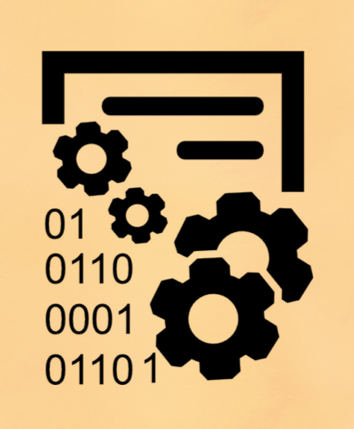
The Tale of Two Source-code Analysis Tools
Learning and experiences
Tushar Sharma
Athens University of Economics and Business
Funded by SENECA project under Marie-Skłodowska Curie Actions
Notes:
This is slightly different presentation – it focusses on application side of source code analysis rather than framework side
What I am going to do is introduce the two source-code analysis tools which I developed, elaborate the features that they support briefly, and bring out challenges, learning and experiences while working on these tools.

Slide 2
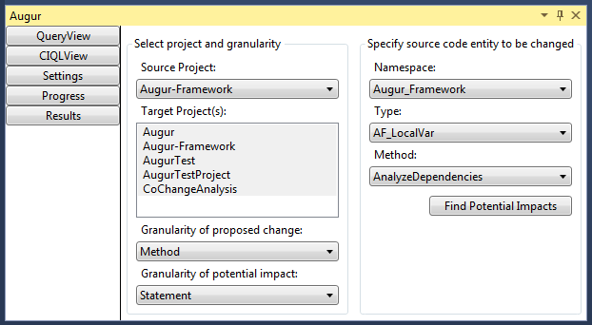
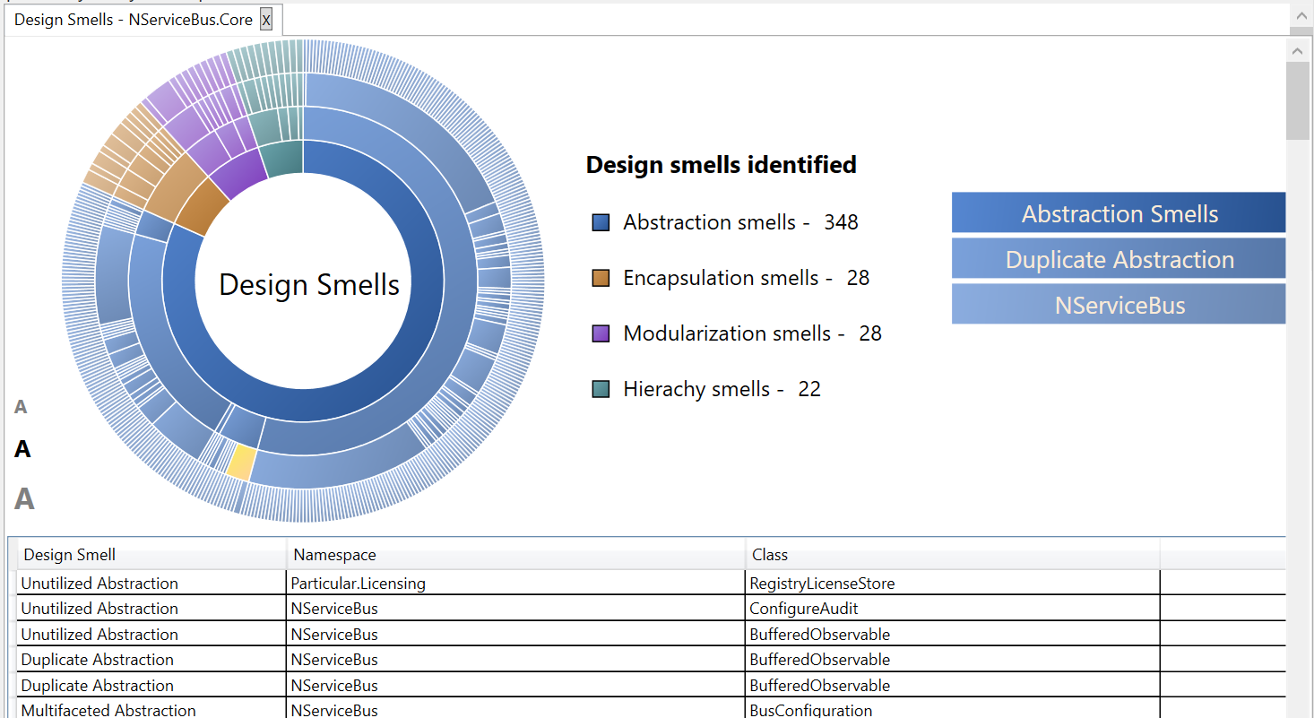
Tools
Augur
Designite
A change impact analysis tool
A software design quality assessment tool
(http://www.designite-tools.com)
Notes:
Augur was developed when I was in Siemens research. I worked on Designite after our book on design smells came out and people started asking how to detect the smells that you described in your book.
Both the tools analyze C# code. Augur is the property of Siemens, so the access is limited to Siemens employees. Designite is a commercial tool, but provides free academic licenses for education and research.

Slide 3
Tools
Augur
Designite
A change impact analysis tool
A software design quality assessment tool
Notes:
What is Augur? It is a change impact analysis tool. That is, when we change a source-code entity (statement, method, class…) what is the potential impact on other source-code entities.

Slide 4
Why we need Augur?
Change is inevitable and continual!

Slide 5
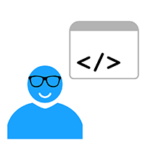
Why we need Augur?
How can I perform maintenance activities effectively in the presence of ripple effect?
-------
----
-----
-------
Software System
Maintain
What if I make a change here and code in some other place break?
How can I understand the impact of a proposed change on various abstraction levels?
Notes:
Maintenance could be:
Adaptive
Corrective
Perfective, or
Preventive
During maintenance, understanding change and the impact of a change is important, required, and desired by the customers.

Slide 6

Features
Change impact analysis with multiple granularity support
Cutting across projects, namespaces, classes, methods, fields, and statements
It’s test
Intra-granular queries
Supporting a query where a change and the associated impact could be on different granularities

Slide 7
Features
Change Impact Query Language (CIQL)
For large scale batch querying – opening a new set of applications of CIA
CIQL::get “<Granularity (Impact)>” [within “<Scope>”]
[with “<Depth>”] where
“<Entity>” is
“<Granularity>”.

Slide 8
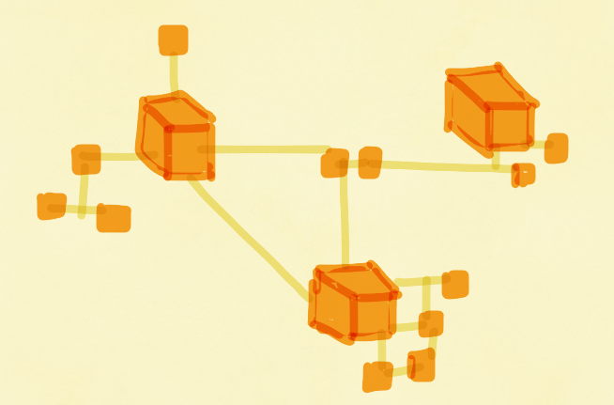
Features
Support for extended dependencies
Data
Control
Semantic
Environment

Slide 9
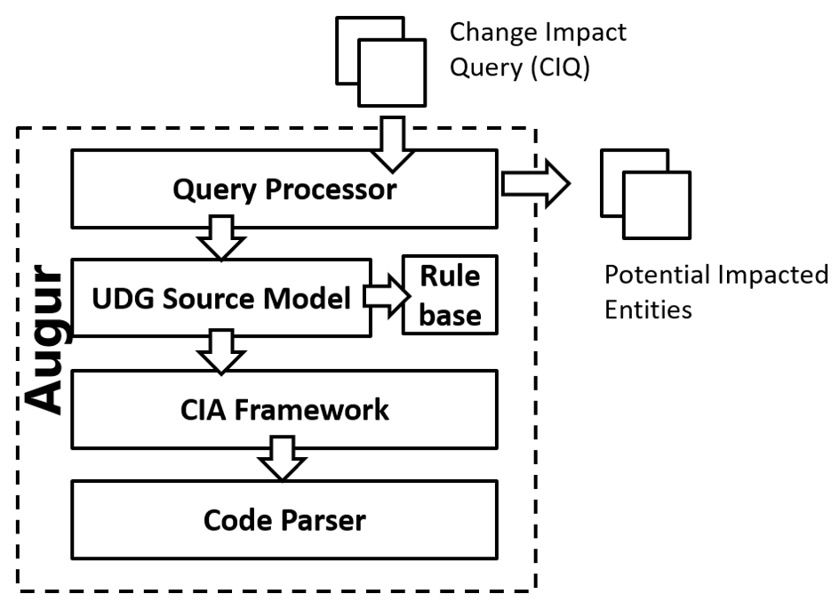
Architecture

Slide 10
Tools
Augur
Designite
A change impact analysis tool
A software design quality assessment tool

Slide 11
Features
Supports detection of 19 design smells and 11 implementation smells

Slide 12
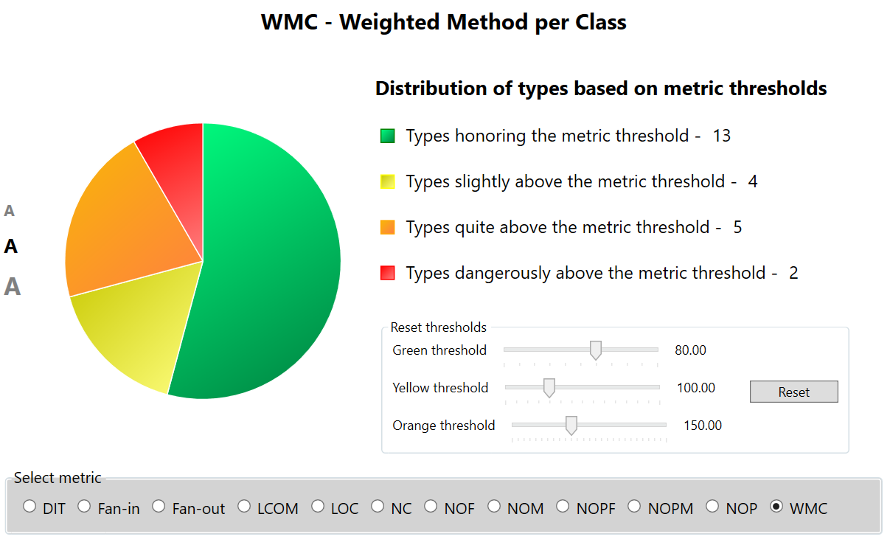
Features
Supports computation of various metrics with custom thresholds

Slide 13
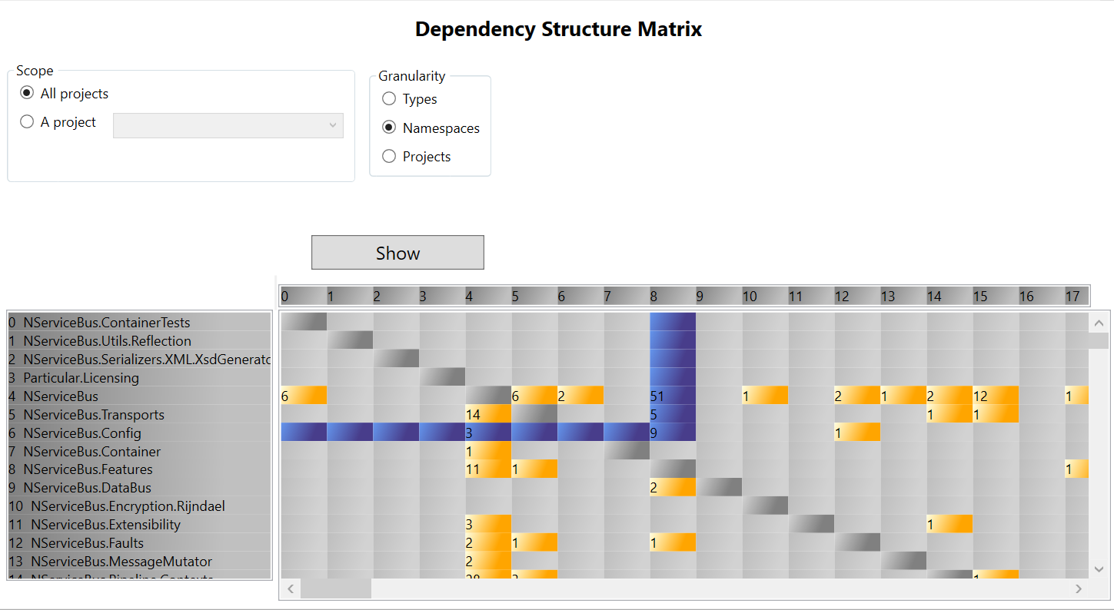
Features
Provides Dependency Structure Matrix

Slide 14
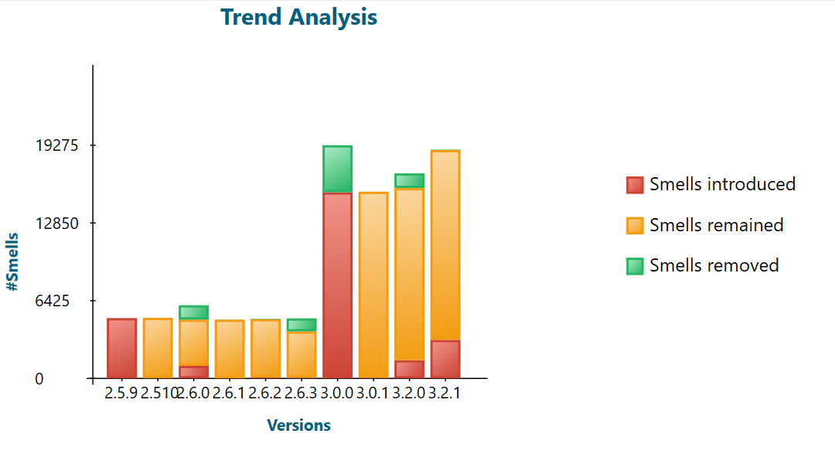
Features
Performs Trend Analysis

Slide 15
Learning and experiences

Slide 16
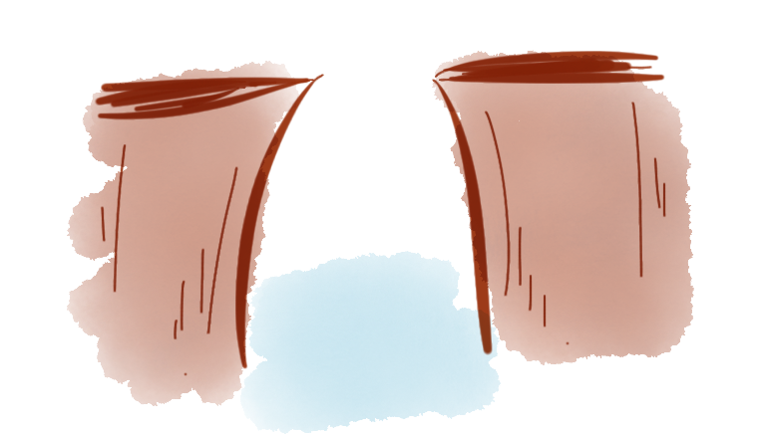
The Big Gap between Academics and Industry
Proposing a new research program in a corporate research organization is not easy!
Notes:
We were fortunate to work with development center where more than 3000 developers are working.
I observed programmers struggling with impact analysis. We conducted a survey also on refactoring, and developers said the lack of appropriate tooling for impact analysis is the biggest technical deterrent for refactoring.
I proposed a new research program but many questioned – “why change impact analysis”. The problem has been in active research since 3 decades.
The answer is that there is not even a single software(either academic or commercial) to support the kind of impact analysis we wanted or even near that. All the research prototypes are either not available or work in a very specific way.

Slide 17
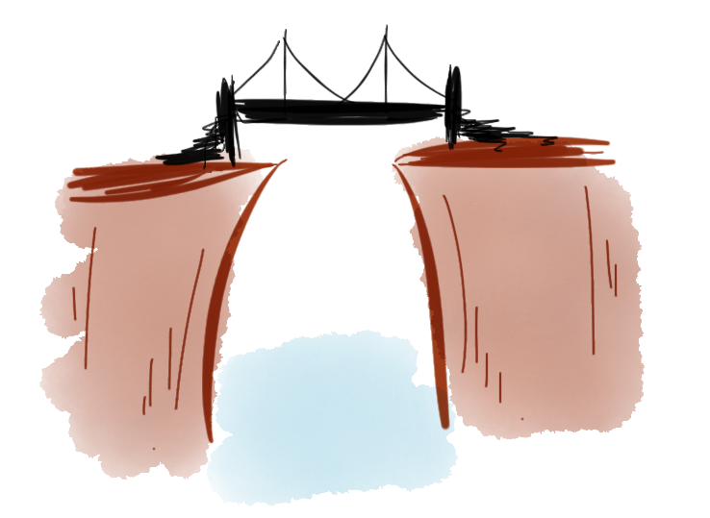
The Big Gap between Academics and Industry
Learning (as a researcher)
- Make sure the availability of artifacts and their broader applicability
Notes:
With appropriate documentation so that others can benefited from it.

Slide 18
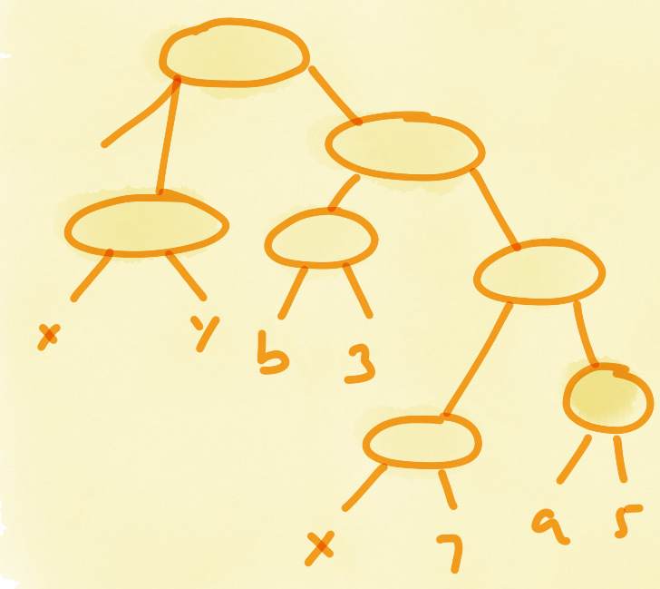
Parsing mechanism
Various options for collecting source code information
String manipulation
Reflection
AST
Byte code analysis

Slide 19

Which AST library?
CSParser
Metaspec
MS Roslyn
#Recognize!
NRefactory
Notes:
Apart from Nrefactory and Roslyn, all are outdated and inactive.

Slide 20
Parsing mechanism
Selection criteria
License
Features
Cost
Community support
Future proof-ness
Notes:
Roslyn CTP was made available in 2011. When we started working on change impact analysis in 2012, we considered the CTP (Community Technology Preview). However, it was clearly mentioned on it’s website that the support of Roslyn can be withdrawn at any time. Clearly, it was not a favorable factor for Roslyn.
So, we opted Nrefactory.

Slide 21
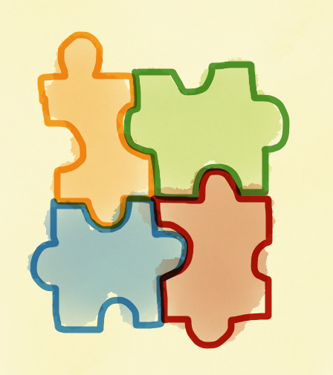
Architecture
Plug-in
or
Independent application
Notes:
This is another early decision that has to be made. Plug-in to VS will bind tightly to VS which will provide much better integration but on the other hands it will made the VS as prerequisite.
User requirements – In our survey, users stated that they want the change impact analysis tool within the IDE
For Designite – I don’t wanted to keep VS as a prerequisite, so developed as an independent tool.

Slide 22
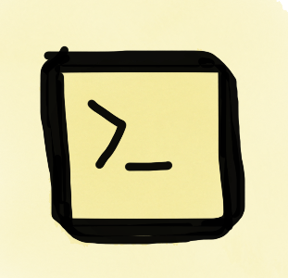
Console application
Options
Use conditional compilation (using ConditionalAttribute)
Duplicate the code-base
Perform architecture refactoring
Notes:
Designite was first designed as a GUI app without any plan to develop console application. Later, based on users inputs, I considered console application of Designite.
Now, it was an application where user interface and business logic was tightly inter-woven. To crete a console application, the first dirty solutions came up was to use duplication where the same functionality is duplicated in two components. Another solution was conditional compilations (using ConditionalAttribute). The more effort intensive task was to perform an architecture refactoring to separate UI with functionality. I did that and it payed me multi-fold.

Slide 23
Console application
Experience:
Architecture refactoring is expensive but effective!
Support for architecture refactoring within IDEs is not sufficient
Notes:
Designite was first designed as a GUI app without any plan to develop console application. Later, based on users inputs, I considered console application of Designite.
Now, it was an application where user interface and business logic was tightly inter-woven. To crete a console application, the first dirty solutions came up was to use duplication where the same functionality is duplicated in two components. Another solution was conditional compilations (using ConditionalAttribute). The more effort intensive task was to perform an architecture refactoring to separate UI with functionality. I did that and it payed me multi-fold.

Slide 24
Extensibility
Smell detection logic must be extensible
i.e. new rules can be added without any change in source code analysis logic and user interface
Learning:
- The role of appropriate design is important
Notes:
the process of identifying smells is – take the input from the user, parse the selected projects, collect useful source code information, analyze the information to detect smells, report them
Now, Designite supported 6 design smells in the first version. So, it must be easy for me to add new rules for smell detection without affecting other rules and analysis logic. Also, user interface must also remain same.
The role of appropriate design is important (for instance, define hierarchies and depend on interfaces rather than concrete classes).

Slide 25
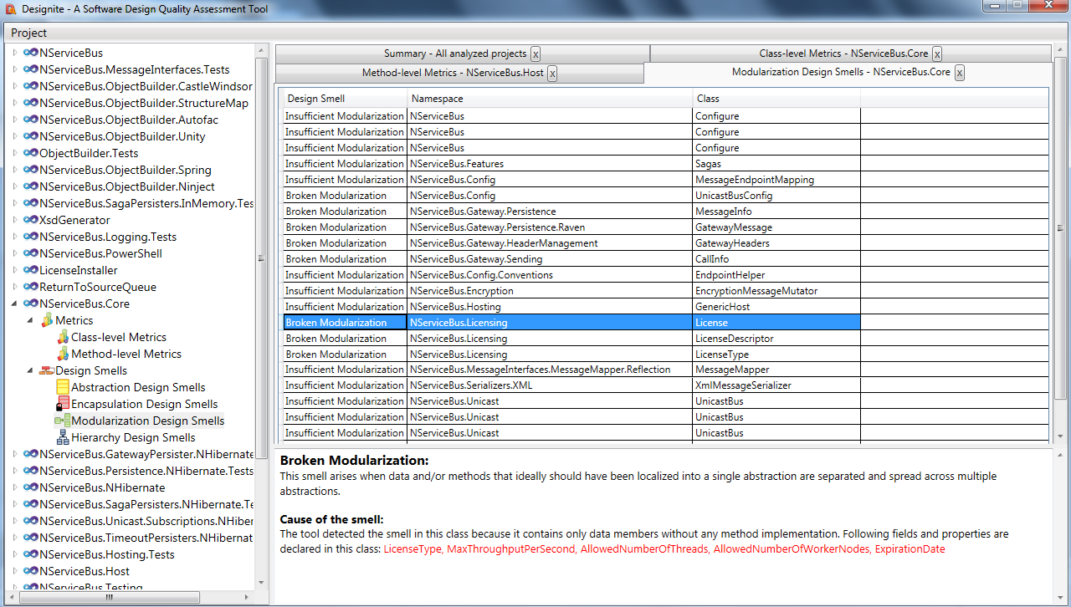
Information dissemination
Producing useful information is desirable; presenting it well to the user is the extra mile.
Notes:
For a commercial software, producing useful information is desirable but probably not enough.
old version of showing detected smell (left capture) vs new version of showing smells (right capture)
The distribution of smells is instantly visible in the sunburst; plus it’s a filtering and navigation mechanism.

Slide 26
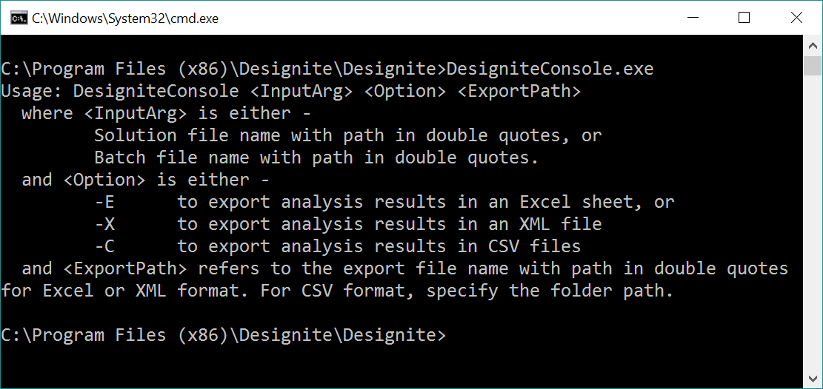
Information dissemination
Different types of users, different requirements.
Notes:
Researchers and pro users wanted a console application for bulk processing and integration with other tools.
A typical developer would be happy with the GUI application.

Slide 27
Paying attention to user requirements
Notes:
Computing metrics is a desired functionality. However, users want to analyze the produced results.
What is the state of their code with respect to a metric?
The pie chart provides an wholistic view of the code w.r.t. to the metrics.
Also, customizable thresholds are desired by users for better metrics analysis.

Slide 28
Paying attention to user requirements
Notes:
Trend analysis is another user requirement.

Slide 29
References
[1] Tushar Sharma, Pratibha Mishra, and Rohit Tiwari. 2016. Designite: a software design quality assessment tool. In Proceedings of the 1st International Workshop on Bringing Architectural Design Thinking into Developers' Daily Activities (BRIDGE '16). ACM, New York, NY, USA, 1-4. DOI: http://dx.doi.org/10.1145/2896935.2896938
2] Tushar Sharma, Girish Suryanarayana. Augur: Incorporating Hidden Dependencies and Variable Granularity in Change Impact Analysis. Submitted at SCAM 2016, waiting for the decision.
Notes:
Trend analysis is another user requirement.

Slide 30
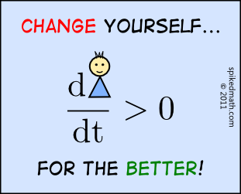
Thank you!!
Courtesy: spikedmath.com
Tushar Sharma
tusharsharma@ieee.org
@Sharma__Tushar

